Slide 1
Postgres Benchmarking
Tyler Race

Slide 2
Postgres
Chose to install postgres on a local virtual machine to have complete control over all system variables
Unique characteristics include being virtualized and running on a solid state drive
All setting left at default during initial installation

Slide 3
Goals
Determine baseline values for a default installation of Postgres
See effects of disabling various optimizations and system settings
Analyze the overall effects of optimizations Postgres implements by default
Get an idea of how difficult it is to force the database to perform poorly

Slide 4
Test slides include this stuff
Experiments slides should include
~1 slide - describe the experiment - what were you trying to learn or test and what did you expect the results to be
~1 slide with a graph (or table) showing the performance results for that experiment - were the results what you expected? what did you learn?

Slide 5
Test 1
10% rule of thumb
How does Postgres perform when settings left at default
Expected results: 10% rule holds true, with a slight variation in the exact number

Slide 6
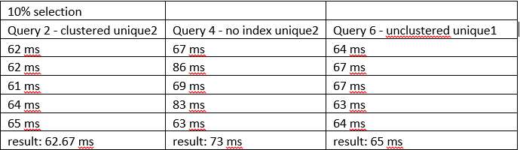
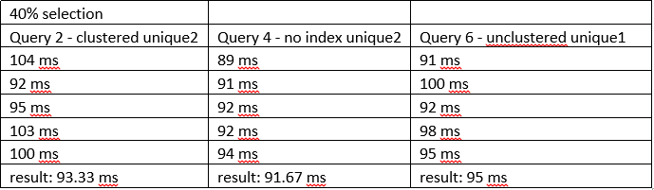
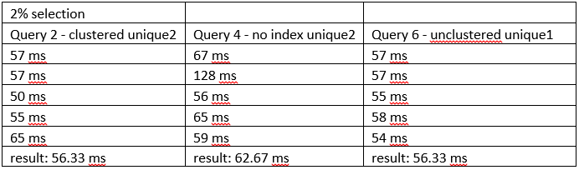
Test 1 Results

Slide 7
Test 1 Results
These results don’t necessarily show that the 10% rule is exactly 10%, but it does demonstrate that the larger the selectivity percentage, the more likely a full table scan will outperform an index scan. In the 40% selectivity, the no index scan outperformed both clustered and unclustered scans. In the 2% selection, the clustered index scan roughly matches the unclustered. Once 10% is hit, the unclustered begins to take a bit longer than the clustered scan, but falls back to around the same during the 40% selection.

Slide 8
Test 2
Join algorithm comparisons
Join on 2 100k tuple tables
Each join algorithm will be timed as before, then it will be disabled
Expected results are increased run times as algorithms are disabled

Slide 9
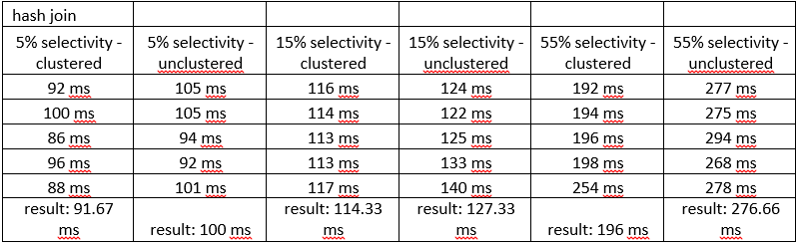
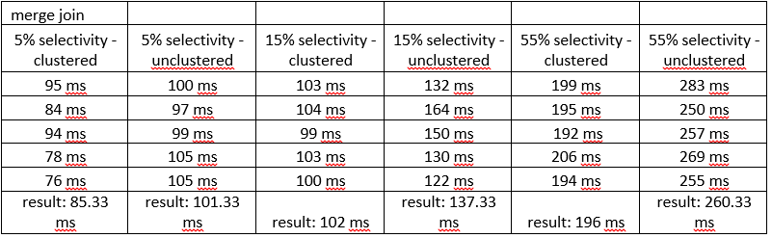
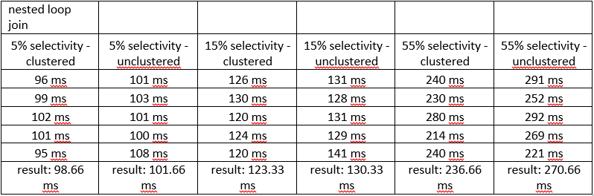
Test 2 Results

Slide 10
Test 2 Results
These results are as expected, but there are a couple interesting tidbits. As the algorithms were disabled, results for 5% selectivity increased for both clustered and unclustered indexes. For 15% selectivity, merge join actually outperformed the hash join by a fairly significant amount. At 55% selectivity, the various algorithms behaved rather similarly.

Slide 11
Test 3
Hot vs. Cold
Run queries with 2% and 55% selectivity on 100k tuples and 1 million tuple relations
Test cold run by completely restarting virtual machine containing Postgres installation before each run
Comparing hot vs. cold, it is expected that hot should perform significantly faster

Slide 12
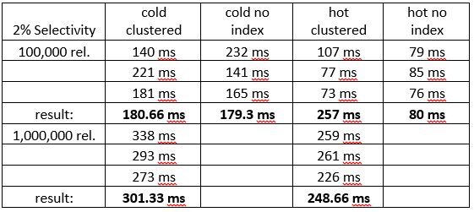
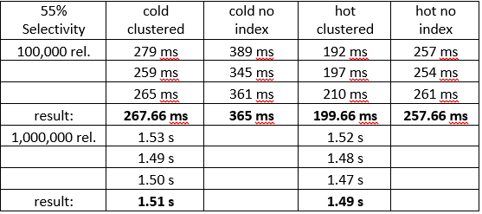
Test 3 Results

Slide 13
Test 3 Results
As expected, the first load of a join query after a server restart is slower than subsequent runs. Rather surprisingly though, the timing saved is not very significant. I expected significant differences in the times, but they are much closer than I had expected. An interesting side note; the computer crashed during the unclustered search with a million relations. This could be due to computational limits, or the table itself could have issues with its values.

Slide 14
Conclusions
To conclude, this benchmark shows that the default Postgres values perform very well, and forcing the database to use less optimization, while impactful, has a minimal effect on database performance.

Slide 15
Lessons
The biggest lesson I learned is that despite many changes in settings including disabling many features that make performance better, the database still performed quite adequately. While there were measurable differences in performance time, the queries still performed quite well. The DBMS has many plan b methods when things don’t work out.
It was difficult to determine the effect of an SSD, since I did not have an equivalent system with a standard HDD. Surely the SSD had a significant increase in performance, but the amount of the effect went untested.

